Slide 1

8th Grade Math: Pre-Algebra
Unit 4, Lesson 5 Evaluating Numerical Expressions with Integer Exponents – Part 2 Volume 1, pg. 143

Slide 2


Benchmark
MA.8.NSO.1.3
Extend previous understanding of the Laws of Exponents to include integer exponents. Apply the Laws of Exponents to evaluate numerical expressions and generate equivalent numerical expressions, limited to integer exponents and rational number bases, with procedural fluency.
volume 1, pg. 143

Slide 3
Integrated Mathematical Thinking and Reasoning Standards
MA.K12.MTR.1.1 Actively participate in effortful learning both individually and collectively.
MA.K12.MTR.3.1 Complete tasks with mathematical fluency.
MA.K12.MTR.4.1 Engage in discussions that reflect on the mathematical thinking of self and others.
MA.K12.MTR.5.1 Use patterns and structure to help understand and connect mathematical concepts.
volume 1, pg. 143

Slide 4

Learning Target
I can evaluate a numerical expression using the laws of exponents.
volume 1, pg. 143

Slide 5

Warm-Up
volume 1, pg. 143

Slide 6
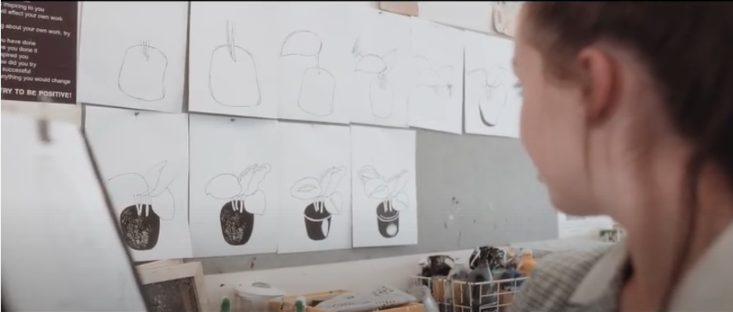
4.5.1 Warm-Up: Mistakes Help You Grow
Two artists are drawing a plant. As they go through the process, both artists make mistakes and start over on their drawings. One of the artists crumples their papers up and throws them on the floor. The other artist hangs them on the wall next to where she is working. What do you think is the purpose of hanging up the drawings with mistakes?
volume 1, pg. 143
Notes:
Video Link: https://algebranation.wistia.com/medias/fi4fidi5y8

Slide 7

Guided Practice
volume 1, pg. 144

Slide 8

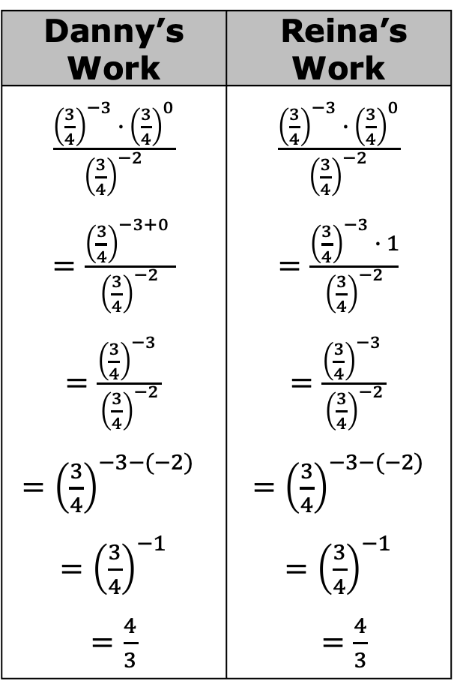
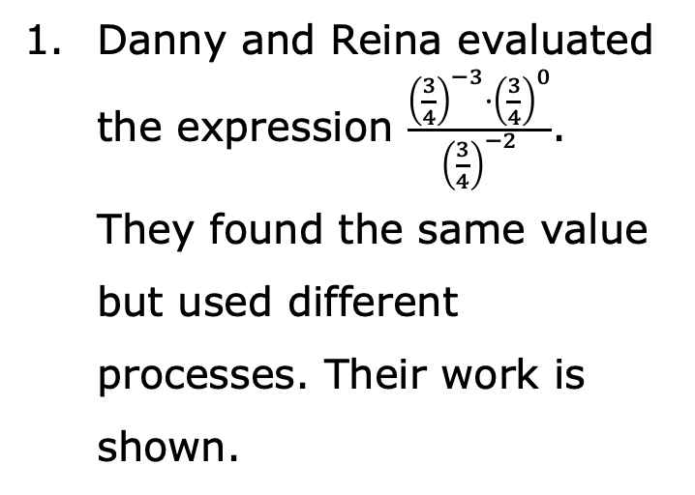
4.5.2 Guided Practice: Evaluating Exponential Expressions
Danny’s Work | Reina’s Work
$\frac{{\left(\frac{3}{4}\right)}^{−3} ∙ {\left(\frac{3}{4}\right)}^{0}}{{\left(\frac{3}{4}\right)}^{−2}}$ $=\frac{{\left(\frac{3}{4}\right)}^{−3+0} }{{\left(\frac{3}{4}\right)}^{−2}}$ $=\frac{{\left(\frac{3}{4}\right)}^{−3} }{{\left(\frac{3}{4}\right)}^{−2}}$ $={\left(\frac{3}{4}\right)}^{−3−(−2)}$ $={\left(\frac{3}{4}\right)}^{−1}$ $=\frac{4}{3}$ | $\frac{{\left(\frac{3}{4}\right)}^{−3} ∙ {\left(\frac{3}{4}\right)}^{0}}{{\left(\frac{3}{4}\right)}^{−2}}$ $=\frac{{\left(\frac{3}{4}\right)}^{−3} ∙ 1}{{\left(\frac{3}{4}\right)}^{−2}}$ $=\frac{{\left(\frac{3}{4}\right)}^{−3} }{{\left(\frac{3}{4}\right)}^{−2}}$ $={\left(\frac{3}{4}\right)}^{−3−(−2)}$ $={\left(\frac{3}{4}\right)}^{−1}$ $=\frac{4}{3}$
Danny and Reina evaluated the expression $\frac{{\left(\frac{3}{4}\right)}^{−3}·{\left(\frac{3}{4}\right)}^{0}}{{\left(\frac{3}{4}\right)}^{−2}}$.
They found the same value but used different processes. Their work is shown.
volume 1, pg. 144

Slide 9

With your partner, discuss and compare how each student evaluated the expression.
Use words or phrases from the bank to complete the descriptions of each student’s work. Some words or phrases will be used more than once and others not at all.
Danny applied the ______________________ exponent law first by rewriting ${\left(\frac{3}{4}\right)}^{−3}·{\left(\frac{3}{4}\right)}^{0}$ as ${\left(\frac{3}{4}\right)}^{−3}$.
zero | identity
power of a power | negative
power of a product | product of powers
power of a quotient | quotient of powers
volume 1, pg. 144

Slide 10
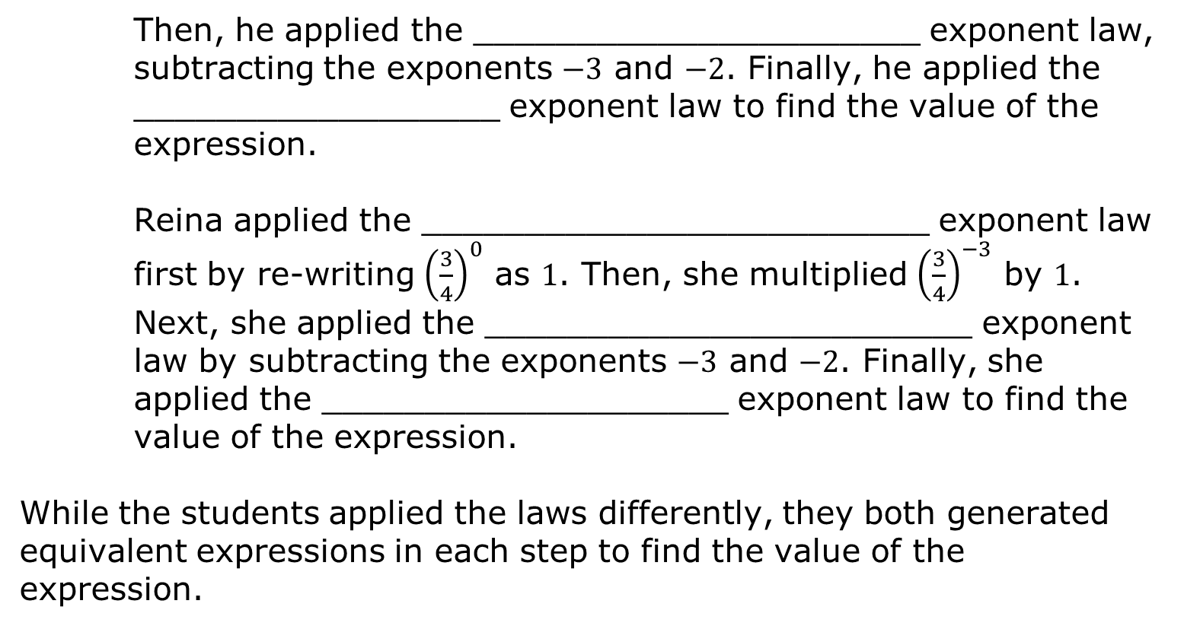
Then, he applied the ______________________ exponent law, subtracting the exponents $−3$ and $−2$. Finally, he applied the __________________ exponent law to find the value of the expression.
Reina applied the _________________________ exponent law first by re-writing ${\left(\frac{3}{4}\right)}^{0}$ as $1$. Then, she multiplied ${\left(\frac{3}{4}\right)}^{−3}$ by $1$. Next, she applied the ________________________ exponent law by subtracting the exponents $−3$ and $−2$. Finally, she applied the ____________________ exponent law to find the value of the expression.
While the students applied the laws differently, they both generated equivalent expressions in each step to find the value of the expression.
volume 1, pg. 144

Slide 11

Try It
volume 1, pg. 145

Slide 12

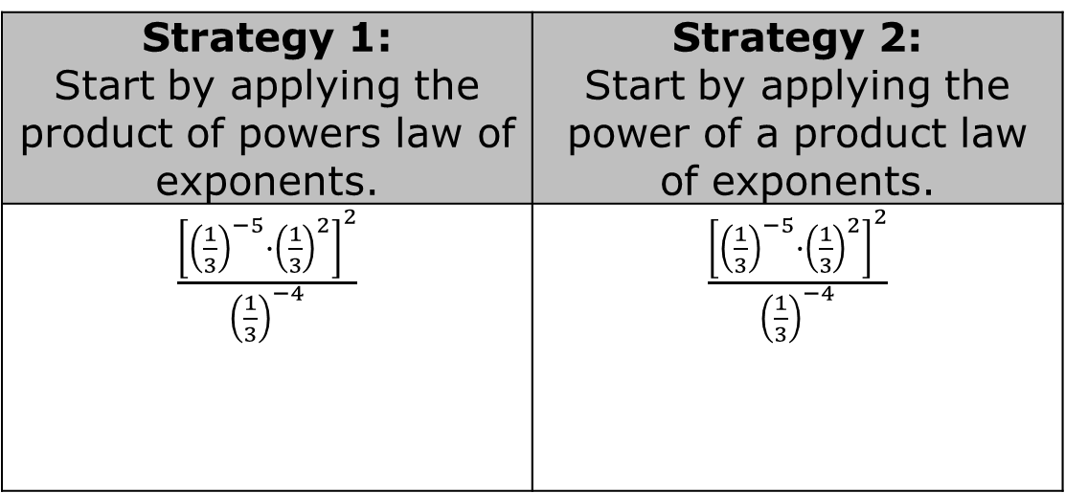
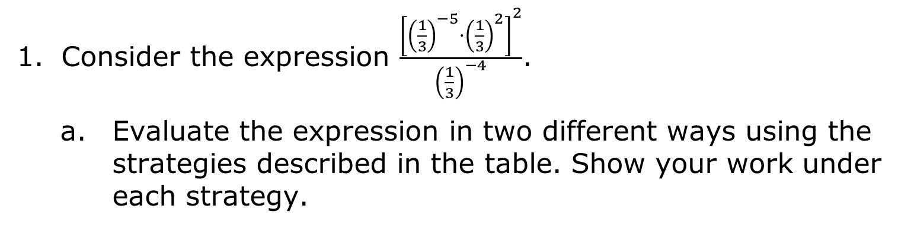
4.5.3 Try It: Evaluating Expressions
Consider the expression $\frac{{\left[{\left(\frac{1}{3}\right)}^{−5}·{\left(\frac{1}{3}\right)}^{2}\right]}^{2}}{{\left(\frac{1}{3}\right)}^{−4}}$.
Evaluate the expression in two different ways using the strategies described in the table. Show your work under each strategy.
Strategy 1: Start by applying the product of powers law of exponents. | Strategy 2: Start by applying the power of a product law of exponents.
$\frac{{\left[{\left(\frac{1}{3}\right)}^{−5}∙{\left(\frac{1}{3}\right)}^{2}\right]}^{2}}{{\left(\frac{1}{3}\right)}^{−4}}$ | $\frac{{\left[{\left(\frac{1}{3}\right)}^{−5}∙{\left(\frac{1}{3}\right)}^{2}\right]}^{2}}{{\left(\frac{1}{3}\right)}^{−4}}$
volume 1, pg. 145

Slide 13
Explain whether or not the quotient of powers law of exponents could have been applied first.
volume 1, pg. 145

Slide 14

Collaboration
volume 1, pg. 145

Slide 15

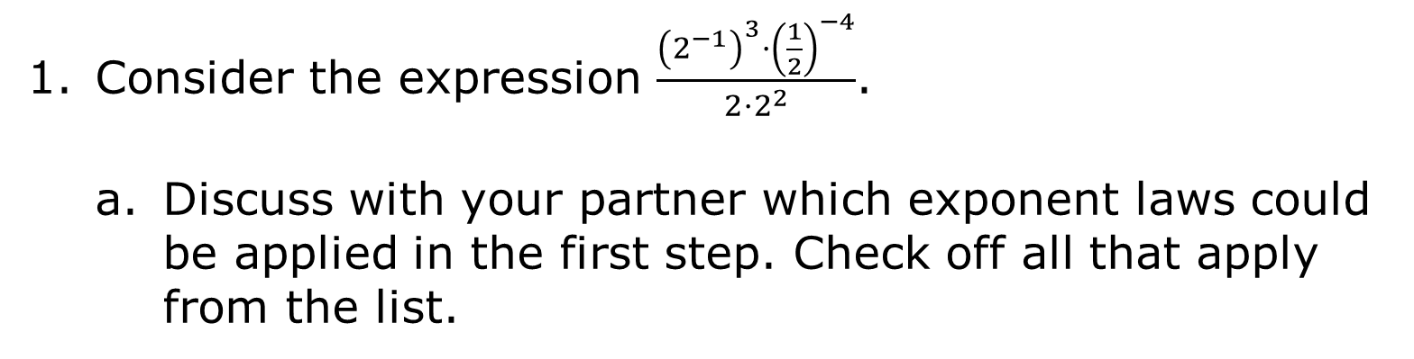
4.5.4 Collaboration: Choose Your Own Adventure!
Consider the expression $\frac{{\left(2^{−1}\right)}^{3}·{\left(\frac{1}{2}\right)}^{−4}}{2·2^{2}}$.
Discuss with your partner which exponent laws could be applied in the first step. Check off all that apply from the list.
Zero Exponent Identity Exponent Negative Exponent Power of a Power | Product of Powers Power of a Product Quotient of Powers Power of a Quotient
volume 1, pg. 145

Slide 16
Evaluate the expression beginning with a different first step than your partner.
Compare your work with your partner’s and come to a consensus about the value of the expression. Discuss the similarities and differences in your work.
volume 1, pg. 145

Slide 17
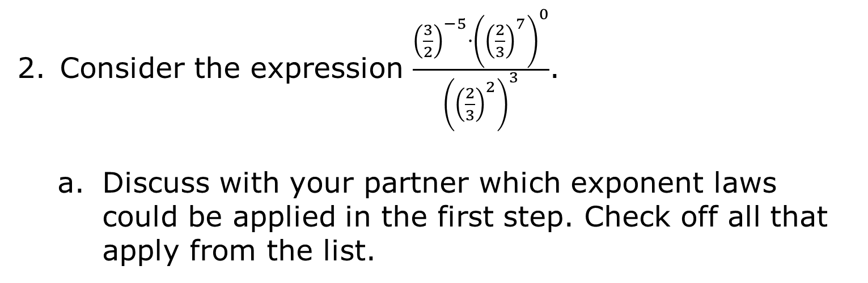
Consider the expression $\frac{{\left(\frac{3}{2}\right)}^{−5}·{\left({\left(\frac{2}{3}\right)}^{7}\right)}^{0}}{{\left({\left(\frac{2}{3}\right)}^{2}\right)}^{3}}$.
Discuss with your partner which exponent laws could be applied in the first step. Check off all that apply from the list.
Zero Exponent Identity Exponent Negative Exponent Power of a Power | Product of Powers Power of a Product Quotient of Powers Power of a Quotient
volume 1, pg. 146

Slide 18
Evaluate the expression beginning with a different first step than your partner.
Compare your work with your partner’s and come to a consensus about the value of the expression. Discuss the similarities and differences in your work.
volume 1, pg. 146

Slide 19

Your Turn
volume 1, pg. 146

Slide 20
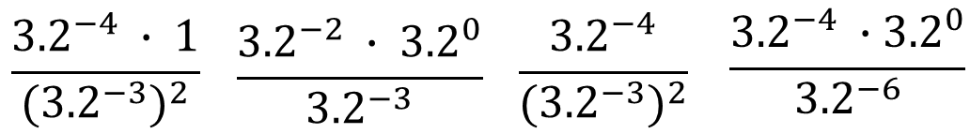
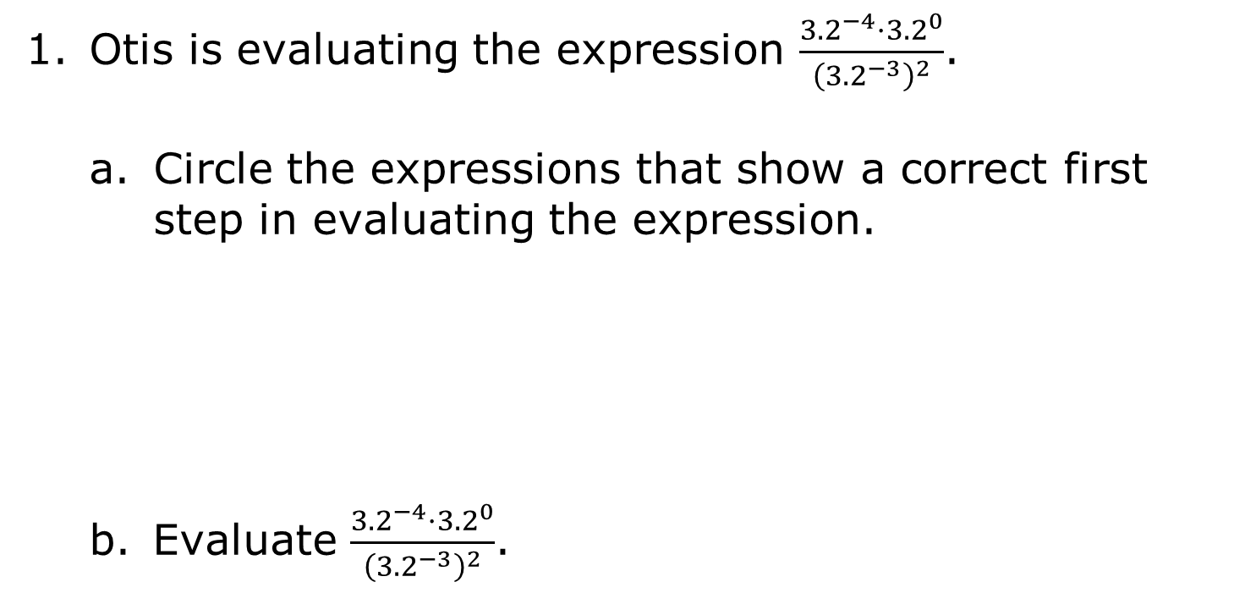
4.5.5 Your Turn!
Otis is evaluating the expression $\frac{{3.2}^{−4}·{3.2}^{0}}{{\left({3.2}^{−3}\right)}^{2}}$.
Circle the expressions that show a correct first step in evaluating the expression.
Evaluate $\frac{{3.2}^{−4}·{3.2}^{0}}{{\left({3.2}^{−3}\right)}^{2}}$.
$$\frac{{3.2}^{−4} ∙ 1}{{({3.2}^{−3})}^{2}}$$ | $$\frac{{3.2}^{−2} ∙ {3.2}^{0}}{{3.2}^{−3}}$$ | $$\frac{{3.2}^{−4}}{{({3.2}^{−3})}^{2}}$$ | $$\frac{{3.2}^{−4} ∙{ 3.2}^{0}}{{3.2}^{−6}}$$
volume 1, pg. 146

Slide 21

Select all the expressions that are equivalent to $\frac{1}{25}$.
${(5}^{3}) ∙ {{(5}^{−1})}^{5}$
$\frac{{(5}^{2}){(5}^{5})}{{(5}^{−2}){(5}^{−4})}$
$\frac{{{(5}^{0})}^{4} ∙{ (5}^{−1})}{5}$
$\frac{{(5}^{2}){(5}^{3})}{{{(5}^{−2})}^{2}}$
$\frac{{(5}^{2}) ∙ 5}{5^{5}}$
volume 1, pg. 146

Slide 22

Wrap-Up
volume 1, pg. 147

Slide 23

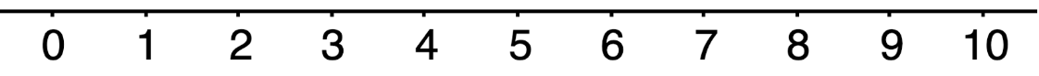
4.5.6 Wrap-Up: Reflection
Use the emoji scale to indicate your level of confidence with evaluating numerical expressions with exponents.
Explain why you chose that level of confidence.
volume 1, pg. 147

